Slide 1



Advanced Ovarian Cancer: Why Should I Recommend BRCA Testing?
Judith Balmaña, MD, PhD
Familial Cancer Program
University Hospital Vall d’Hebron
Barcelona, Spain
www.prIMEoncology.org

Slide 2
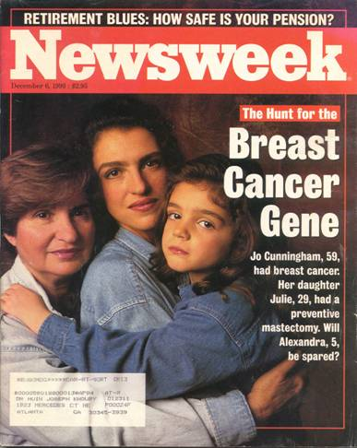


What Are the Reasons to Undergo BRCA Genetic Testing?
Risk assessment
Therapeutic decision-making
Prophylactic surgery
Systemic therapies

Slide 3
Prevalence of BRCA Mutations in Unselected Patients With Ovarian Cancer
Study | Population | Main Features | BRCA1/2 Frequency
Hirsh-Yechezkel, 2003 (Israel)¹ | 896 3 founder mutations | 779 invasive 117 borderline | 29% 4% (similar to the rate in the general Israeli population)
Risch, 2006 (Ontario, Canada)² | 1171 PTT and DHPLC | 977 invasive 194 borderline | Overall 13% Serous 18% Endometrioid/clear cell 7% Borderline/Mucinous 0%
Malander , 2004 (Southern Sweden)³ | 161 PTT and DHPLC | All invasive Borderline excluded | Overall 8% Serous 8% Endometrioid 13% Mucinous 0%
Soegaard, 2008 (Denmark)⁴ | 445 Sequencing and MLPA | All Invasive Borderline excluded | Overall 6% Serous 5.4% Endometriod 5.4% Clear cell 9% Mucinous 0%
1. Hirsh-Yechezkel G, et al. Gynecol Oncol. 2003;89(3):494-498. 2. Risch HA, et al. J Natl Cancer Inst. 2006;98(23):
1694-1706. 3. Malander S, et al. Eur J Cancer. 2004;40(3):422-428. 4. Soegaard M, et al. Clin Cancer Rev. 2008;14(12):
3761-3767.

Slide 4
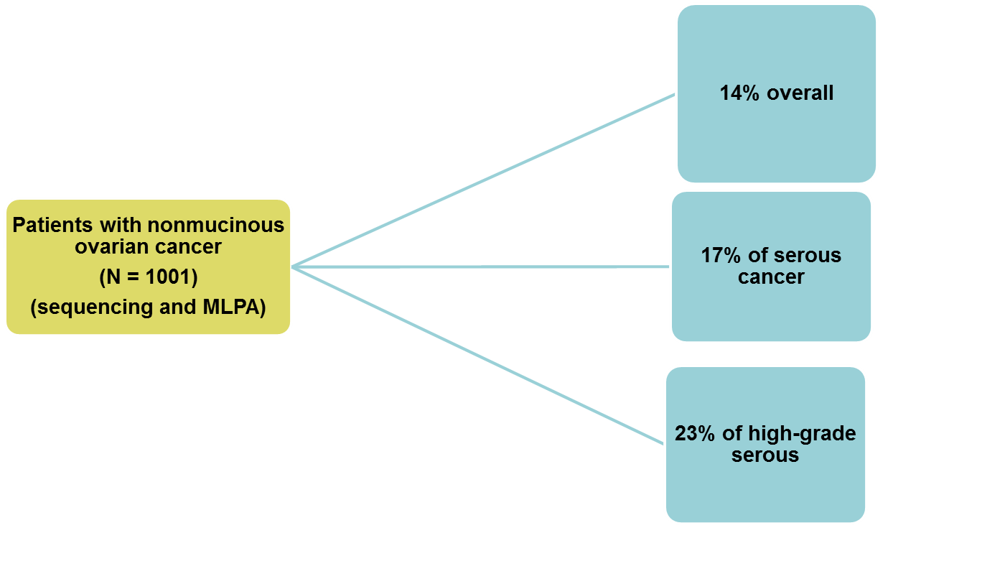
Australian Population-Based Study of BRCA Mutation in Patients With Ovarian Cancer
BRCA mutations:

Slide 5
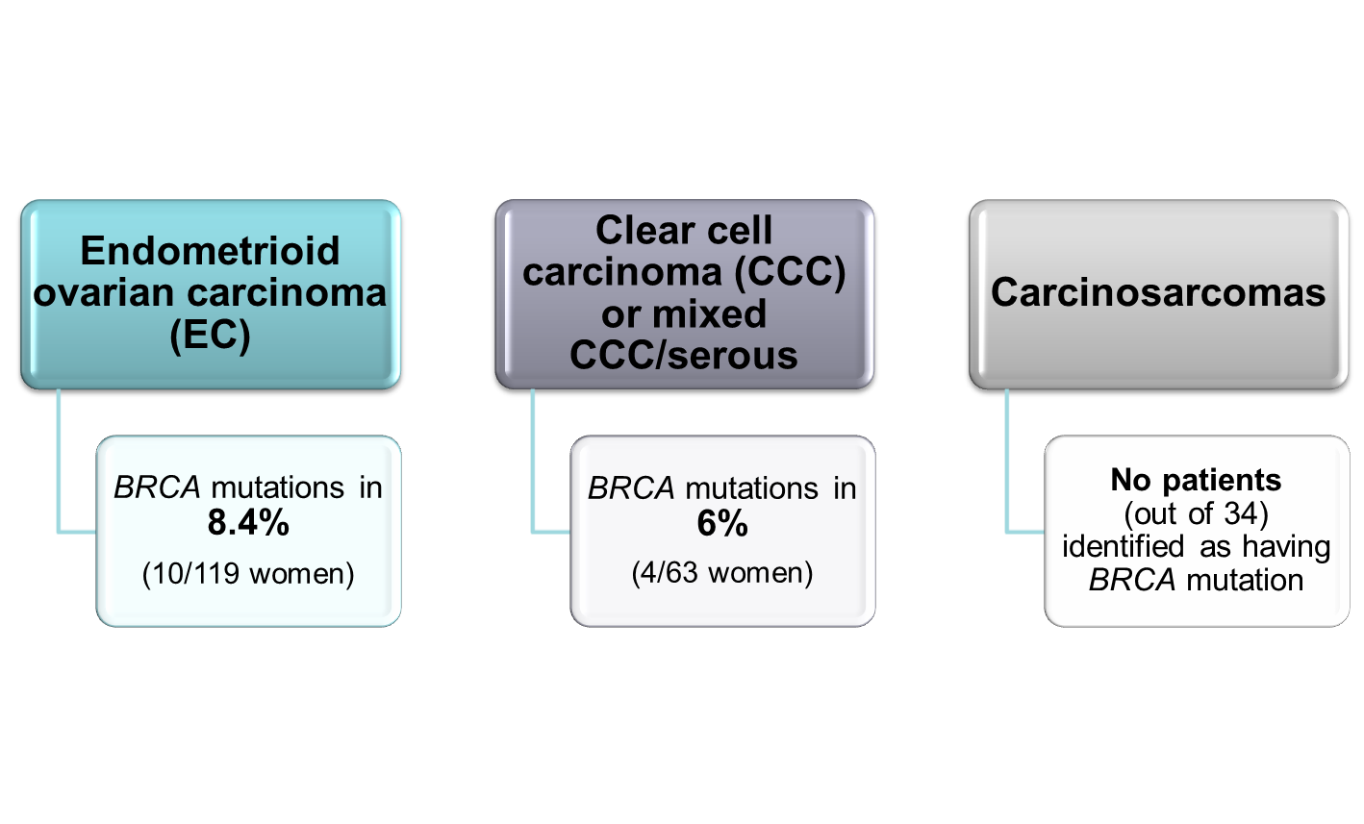
BRCA1/2 Germline Mutations Were Not Limited to High-Grade Serous Cancer

Slide 6
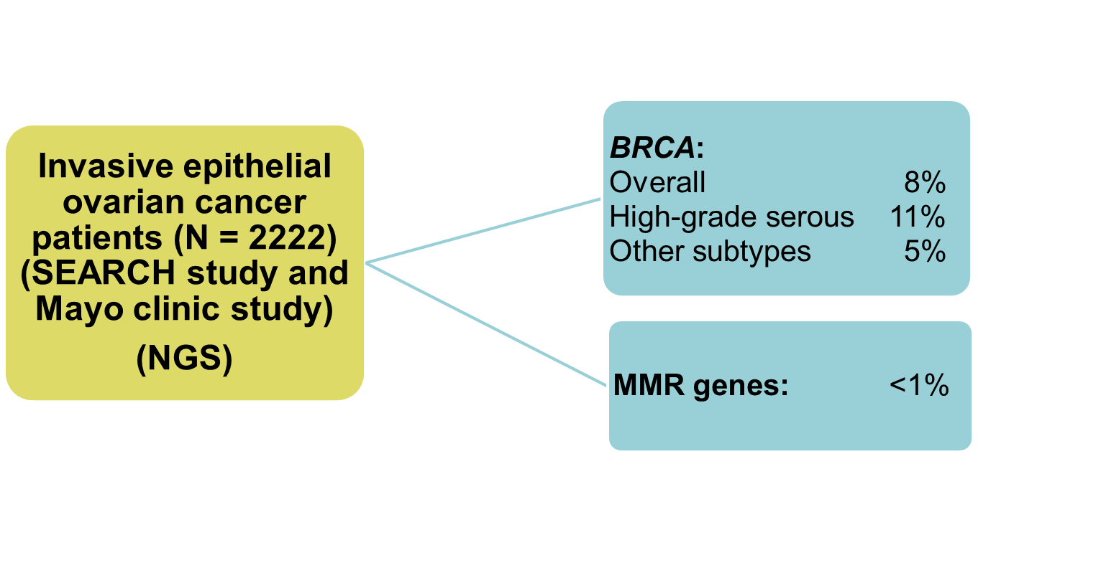
Mutation in BRCA (and MMR Genes) Among Patients With Ovarian Cancer in the Population
Song H, et al. Hum Mol Genet. 2014;23(17):4703-4709.
Notes:
Their PCR based method was not able to detect large genomic rearrangements; the mean coverage of coding sequences was 84%. In the concordance study with positive controls, 3 mutations were missed because the read depth of the relevant amplicon was <15
Epithelial ovarian tumors included serous (57%), endometrioid (14%), clear cell (9%) and mucinous (7%)

Slide 7
Is Age at Diagnosis a Predictor of a BRCA Mutation?
 | BRCA1/2 - | BRCA1 + | BRCA2 +
Alsop et al | 60y | 53 y | 60 y
Soegaard et al | 61 y | 49 y
Risch et al | 56 y | 51 y | 57 y
Malander et al | 59 y | 57 y
Song et al | 59 y | 52y | 57y
Approximately 25% of BRCA1/2 mutation carriers
are older than 60 years
Alsop K, et al. J Clin Oncol. 2012;30(21):2654-2663. Soegaard M, et al. Clin Cancer Rev. 2008;14(12):3761-3767.
Risch HA, et al. J Natl Cancer Inst. 2006;98(23):1694-1706. Malander S, et al. Eur J Cancer. 2004;40(3):422-428.
Song H, et al. Hum Mol Genet. 2014;23(17):4703-4709.

Slide 8
Is Family History a Predictor of a BRCA Mutation?
 | Frequency of BRCA in the Presence of Family History | Frequency of BRCA in the Absence of Family History | Percentage of BRCA Mutation Carriers Who Lack a Family History
Walsh et al | 29% | 8% | 27%
Soegaard et al | 27% | 3.5% | 54%
Malander et al | 92% | 0% | 8%
Risch et al | 34% | 5% | 37%
Alsop et al | 39% | 8% | 44%
Song et al | 19% | 5% | 39%
Approximately 35% of BRCA1/2 mutation carriers
do not have a family history
Walsh T, et al. Proc Natl Acad Sci U S A. 2011;108(44):18032-18037. Soegaard M, et al. Clin Cancer Rev. 2008;14(12):3761-3767. Malander S, et al. Eur J Cancer. 2004;40(3):422-428. Risch HA, et al. J Natl Cancer Inst. 2006;98(23):1694-1706. Alsop K, et al. J Clin Oncol. 2012;30(21):2654-2663. Song H, et al. Hum Mol Genet. 2014;23(17):4703-4709.

Slide 9
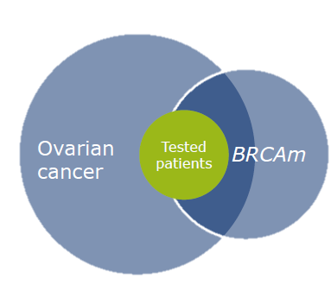
BRCA Testing Among Patients
With Ovarian Cancer
6% to 14% of unselected patients with an epithelial ovarian cancer may carry a BRCA mutation
Old age at diagnosis or
absence of family history
does not exclude the
presence of a germline
mutation

Slide 10
Recent Recommendations for Genetic Testing of Ovarian Cancer
Australian National Guidelines (July 2013):
    Women ≤70 years of age with ovarian cancer can receive genetic testing for BRCA1/2 mutations, regardless of family history
NCCN ( V1, February 2014):
    Epithelial ovarian cancer at any age
SGO (March 2014):
    Women diagnosed with epithelial ovarian, tubal, and peritoneal cancers should be considered for genetic counseling and testing, even in the absence of a family history
Europe: No standardized guidelines, vary by country

Slide 11
BRCA Somatic Mutations in Ovarian Cancer
 | Population | Frequency of Somatic Mutations
Hennessy et al | 235 unselected epithelial ovarian cancers | 11/235: 5%
TCGA network | 489 high-grade serous ovarian cancers | 20/316: 6.3%
Alsop et al | 1001 nonmucinous ovarian cancers | 8/132: 6%
Pennington et al | 390 ovarian carcinomas | 25/367: 7%
Ledermann et al | 265 high-grade, recurrent ovarian carcinomas, platinum-sensitive | 18/265: 7%
Hennessy BT, et al. J Clin Oncol. 2010;28(22):3570-3576. The Cancer Genome Atlas Research Network. Nature. 2011;474(7353):609-615. Alsop K, et al. J Clin Oncol. 2012;30(21):2654-2663. Pennington P, et al. Clin Cancer Res. 2014;20(3):764-775. Ledermann J, et al. Lancet Oncol. 2014;15(8):852-861.

Slide 12

Somatic Mutations in BRCA1 and BRCA2
1.0
0.8
0.6
0.4
0.2
0.0
BRCA Wildtype
BRCA Mutation
235 unselected ovarian cancers
44 mutations:
  30% were somatic
  Somatic mutations were more frequently novel
No somatic mutations detected in tumors from patients with germline mutations
PFS was not significantly different based upon the origin of the mutation (P = .69)
20 40 60 80 100 120
Times, months
Multivariable Cox Model of PFS in Women With Ovarian Cancer
Variable | P | Hazard Ratio | 95% CI
Residual disease | .003 | 1.80 | 1.25 to 2.59
Stage | .002 | 2.43 | 1.30 to 4.54
Grade | .027 | 1.76 | 1.03 to 2.99
BRCA1/2 mutation status | .019 | 0.61 | 0.39 to 0.94
Hennessy BT, et al. J Clin Oncol. 2010;28(22):3570-3576.

Slide 13


Germline and Somatic HR Mutations Predictive of Platinum Sensitivity
Pennington P, et al. Clin Cancer Res. 2014;20(3):764-775.
25% (4/16) of tumors responding to platinum on a third occasion had a pathogenic somatic BRCA mutation
(Alsop K, et al. J Clin Oncol. 2012;30(21):2654-2663.)

Slide 14


Olaparib Maintenance Therapy in Patients With Platinum-Sensitive Relapsed Serous Ovarian Cancer: A Preplanned Retrospective Analysis of Outcomes by BRCA Status in a Randomized Phase II Trial
136/254 (51%) BRCA1 or BRCA2 mutated: 96 germline, 18 somatic (7%)
Small group, but not differences according to mutation origin (ie, germline or somatic)
PFS
Patients with BRCA mutation (n = 136)
OS
Patients with BRCA mutation (n = 136)
 | Olaparib | Placebo
Events/total patients (%) | 26/74 (35%) | 46/62 (74%)
Median PFS, months (95% CI) | 11.2 (8.3 – NC) | 4.3 (3.0 – 5.4)
HR 0.18 (95% CI 0.10 – 0.31); P<.0001
100
90
80
70
60
50
40
30
20
10
0
100
90
80
70
60
50
40
30
20
10
0
 | Olaparib | Placebo
Deaths/total patients (%) | 37/74 (50%) | 34/62 (55%)
Median OS, months (95% CI) | 34.9 (29.2 – NC) | 31.9 (23.1 – 40.7)
HR 0.73 (95% CI 0.45 – 1.17); P = .19
0 3 6 9 12 15
74 59 34 15 5 0
62 35 13 2 0 0
Number at risk
Olaparib
Placebo
0 3 6 9 12 15 18 21 24 27 30 33 36 39 42 45 48
71 69 67 65 62 56 53 50 48 39 36 26 12 7 0 0
62 62 58 50 46 39 36 33 29 29 27 21 10 4 0 0
Number at risk
Olaparib
Placebo
Ledermann J, et al. Lancet Oncol. 2014;15(8):852-861.

Slide 15

BRCA1
BRCA2
Breast cancer
Ovarian cancer
Contralateral breast cancer
Breast cancer
Ovarian cancer
Contralateral breast cancer
100
90
80
70
60
50
40
30
20
10
0
100
90
80
70
60
50
40
30
20
10
0
20 25 30 35 40 45 50 55 60 65 70 75
20 25 30 35 40 45 50 55 60 65 70 75
Age, years
Age, years
5-year survival ovarian cancer: BRCA1 44%
BRCA2 61%
No mutation 25%
Yang D, et al. JAMA. 2011;306(14):1557-1565. Mavaddat N, et al. J Natl Cancer Inst. 2013;105(11):812-822.

Slide 16
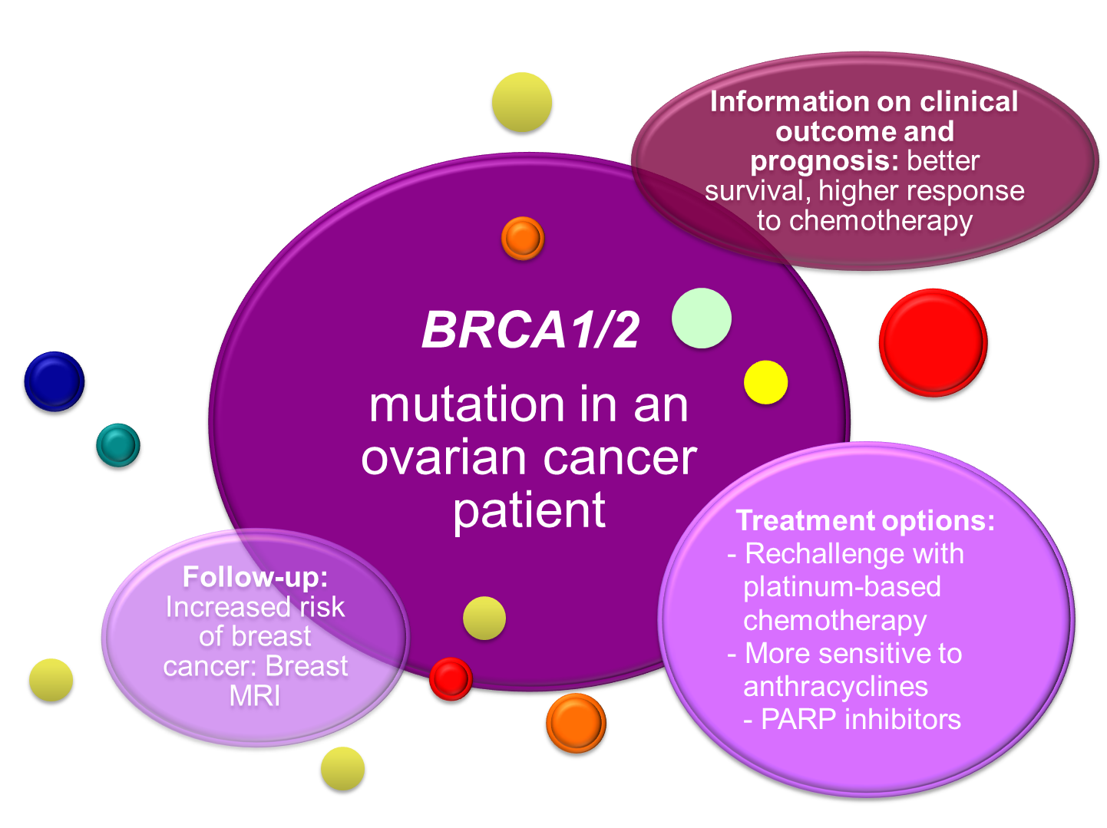

Family communication: Identify family members at risk of BRCA cancers

Slide 17
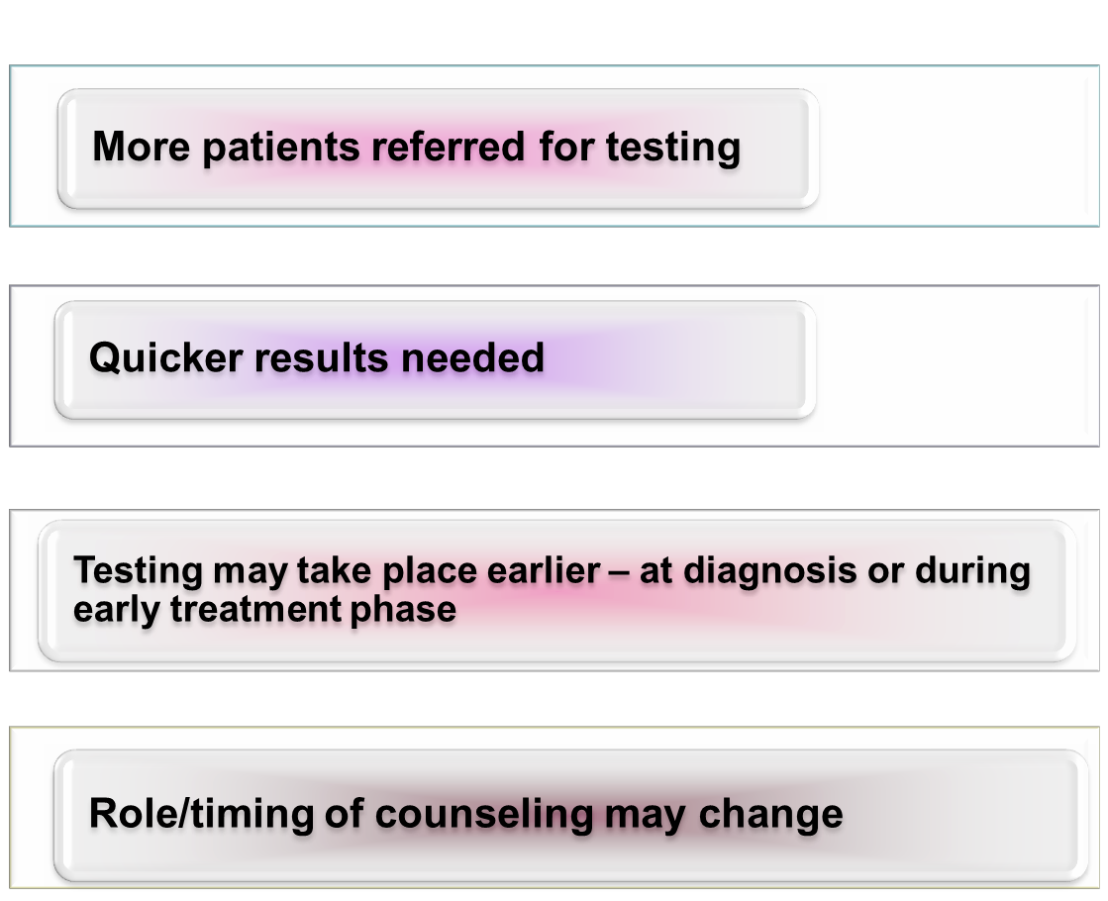
How BRCA Testing May Change With the Introduction of Specific BRCA Therapies

Slide 18


Clinical Use of BRCA Genetic Testing

Slide 19
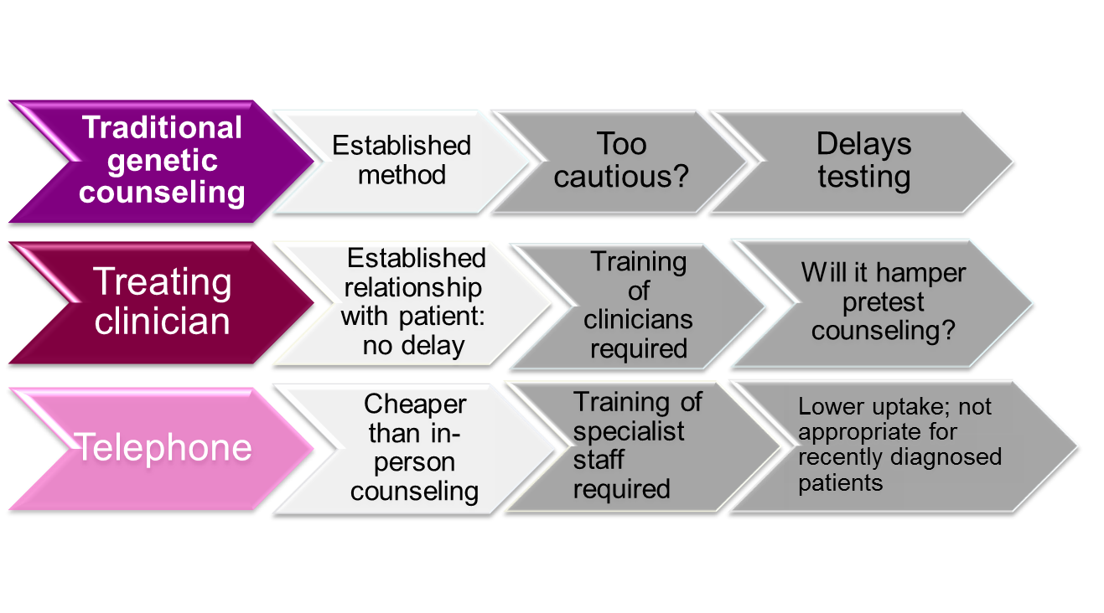
Genetic Counseling Models
Meiser B, et al. Gynecol Oncol. 2012;124(1):153-157. Schwartz MD, et al. J Clin Oncol. 2014;32(7):618-626.
Aire S, BMJ 2014; Sie AS, et al. Fam Cancer. 2013;12(4):675-682.

Slide 20

Conclusions
Approximately 10% of invasive epithelial nonmucinous, ovarian cancers are associated with a germline BRCA1/2 mutations
Somatic BRCA mutations are identified in approximately 5% to 7% of epithelial ovarian cancer
Around 1/3 of BRCA carriers with ovarian cancer do not have a family history of breast/ovarian cancer, or have been
diagnosed at an age >60 years

Slide 21
Conclusions
BRCA-carriers with ovarian cancer have
better outcomes and are more sensitive to platinum-based chemotherapy and PARPi than noncarriers
Patients with invasive epithelial ovarian cancer should be considered for BRCA testing
A germline BRCA mutation is not a conventional biomarker: multiple clinical and familial implications

